Slide 1
EDITH: ECG BIOMETRICS AIDED BY DEEP LEARNING FOR RELIABL E INDIVIDUAL
AUTHENTICATION
GUIDED BY
Dr.R.Shyamala,M.E.,Ph.D.,AP/IT
TEAM MEMBERS
Aboorva S (422419205002)
Priyadharshini M (422419205027)
Sakthi P (422419205032)
Shanmathi U (422419205035)

Slide 2
LITERATURE SURVEY
S.NO | TITLE & AUTHOR | JOURNAL & YEAR | PROBLEM | SOLUTION | PARAMETERS MEASURED | ADVANTAGES | DISADVANTAGES
1. | TITLE: EDITH : ECG biometrics aided by Deep learning for reliable Individual authentication. AUTHOR:A Nabil Ibtehaz,etal. | IEEE transactions on emerging topics in computational intelligence& 2022. | Behavioural authentication system are cumbersome and unreliable. | Deep learning techniques, specifically convolutional neural networks (CNNs)extract discriminative features | Accuracy rate, Performance of FAR,FRR,EER | Inherent robustness against forgery. | High computational requirements, resource-intensive training and inference process.
2. | TITLE: Robust R-peak detection in low quality Holter ECGs using 1D convolutional neural network. AUTHOR: Muhammad Uzair Zahid,etal. | IEEE Transactions on biomedical engineering& Jan 2022. | Difficulty in accurately detecting R-peaks in Holter ECG recordings with low signal quality. | Implementation of the 1D convolutional neural network . | Positive predictive value, Sensitivity on MIT-BIH Arrhythmia dataset. | Reduce the false positive and false negative in Holter ECG signals by more than 54% and 82%. | Complexity and less performance.

Slide 3
3. | TITLE:A deep learning approach for robust R-peak detection in noisy ECG. AUTHOR: Sricharan Vijayrangan,etal. | Annual international conference of the IEEE engineering in Medicine and Biology Society (EMBC)& 2020 | Issues of variability and sparsity of ECG R- Peaks | Application of the Unet architecture. | Precision, Recall, F1-Score. | Robustness and versatility. | Hard to detect the R-peak accurately for an Untrained human eye.
4. | TITLE: A Comprehensive survey on ECG Signals as new biometric modality for human authentication. AUTHOR: Anthony Ngozichukwuka Uwaechia,etal. | IEEE access& Jul 2020 | To realize biometric identification systems precisely and robustly. | Fiducial and Non fiducial techniques Kalman based detection methodology | Heart rate variability, Morphological features, Heartbeat timing. | Increased recognition performance, enhanced security and fewer enrolment problems. | Crucial for two factor authentication.
5. | TITLE: ECG biometric authentication: A comparative analysis. AUTHOR: Mohit Ingale,etal. | IEEE access &June 2020 | It shows inherent vulnerabilities. | DTW matching algorithm and Kalman filter | Recognition time, EER, Processing time. | Better performance in identification rate, FAR, FRR, EER. | High chances of Spoofing.

Slide 4
PROBLEM STATEMENT
Who does the problem affect? | Users, Organizations, Developers and Researchers.
What are the boundaries of the problem? | Security measures, Signal quality, variations in signals, user acceptance.
What is the issue? | Stealing password or keys, Unauthorized Access, Spoofing or counterfeit attacks.
When does the issue occur? | When a user tries to authenticate into a system.
Where does the issue occur? | During the different stages of authentication process including enrolment, signal acquisition, feature extraction and matching.
Why is it important that we fix the problem? | To overcome all the issues like spoofing attacks, unauthorized access, to protect individual privacy and to prevent identity frauds.
What solution to solve this issue? | Robust data acquisition, to implement physiological signal based authentication using ECG signal.
What methodology used to solve the issue? | Feature Extraction, Secure signal acquisition, Continuous monitoring, R-Peak detection.

Slide 5
PROPOSED SOLUTION
S:No | PARAMETERS | DESCRIPTION
1. | Problem statement | To develop and implement an ECG biometric authentication system that is reliable, secure, and user-friendly, while considering potential medical limitations and ethical and legal implications.
2. | Idea/Solution description | To extract unique features from ECG signals and authenticate based on their ECG signature using large dataset which is used to train and validate the deep learning models for reliable authentication.
3. | Novelty/Uniqueness | Uniqueness: ECG signals are unique to each individual and do not change significantly over time, making them a highly reliable biometric modality for authentication. Potential for continuous authentication: User can be authenticated in real-time based on their ECG signals. This can be beneficial for applications such as remote healthcare monitoring or secure access to buildings, where continuous authentication can provide an extra layer of security and convenience.

Slide 6
4. | Social impact/customer satisfaction | Security: It can improve security. Customer Satisfaction: It increases customer satisfaction, and reduce errors. Industrial Satisfaction: It offers a non-invasive and user-friendly method of authentication that can be beneficial in healthcare , banking, and government sectors.
5. | Business model (Revenue model) | Licensing: The business licenses its ECG biometric authentication technology to other business such as security companies, health care etc., Subscription: The business offers ECG biometric authentication such as a subscription-based service, charging customers a recurring fee for access to its technology. Partnership: Business Partnerships such as value-added service, and earns a share of the revenue generate by those partnerships.
6. | Scalability of the solution | The solution is highly scalable and adaptable across various sectors, including large-scale operations, and can be continuously improved.

Slide 7
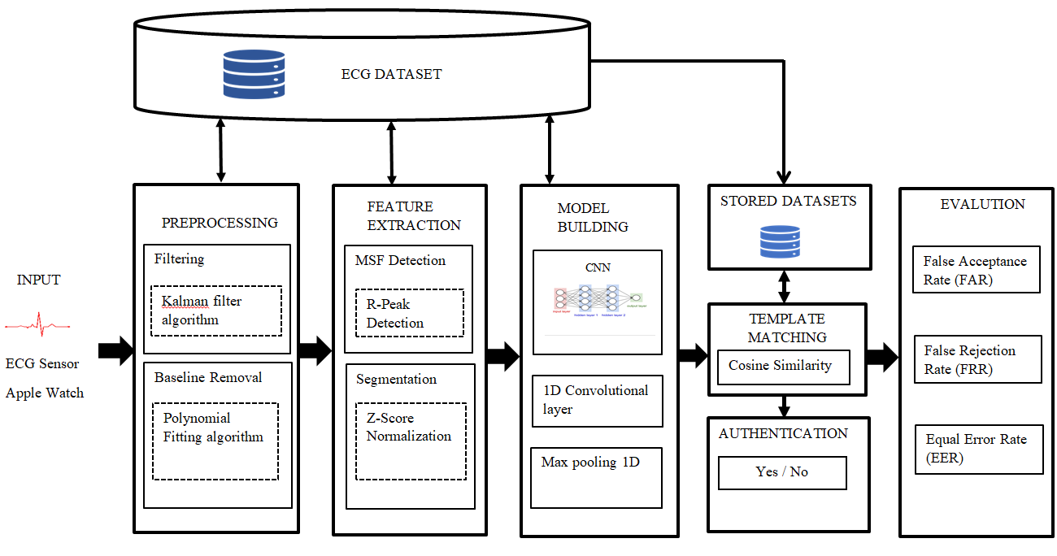
SYSTEM ARCHITECHTURE

Slide 8
MODULE SPLIT-UPS
MODULE 1 - PRE-PROCESSING
1.1 KALMAN FILTER ALGORITHM
Input : Raw ECG data
Output : De-noising ECG data
Step 1: Initialization
Initialize the state estimate: x̂₀|₀.
Initialize the error covariance matrix: P₀|₀.
Initialize the process noise covariance matrix: Q.
Initialize the measurement noise covariance matrix: R.
Step 2: Prediction (Time Update):
Project the state estimate ahead: x̂ₖ|ₖ₋₁ = F ⋅ x̂ₖ₋₁|ₖ₋₁ + B ⋅ uₖ.
Project the error covariance ahead: Pₖ|ₖ₋₁ = F ⋅ Pₖ₋₁|ₖ₋₁ ⋅ Fᵀ + Q.
Step 3: Update (Measurement Update):
Compute the Kalman gain: Kₖ = Pₖ|ₖ₋₁ ⋅ Hᵀ ⋅ (H ⋅ Pₖ|ₖ₋₁ ⋅ Hᵀ + R)⁻¹.
Update the state estimate: x̂ₖ|ₖ = x̂ₖ|ₖ₋₁ + Kₖ ⋅ (zₖ - H ⋅ x̂ₖ|ₖ₋₁).
Update the error covariance: Pₖ|ₖ = (I - Kₖ ⋅ H) ⋅ Pₖ|ₖ₋₁

Slide 9
1.2 POLYNOMIAL FITTING ALGORITHM
Input = Raw ECG data
Output = Remove baseline wander
Given a set of data points (xᵢ, yᵢ) where i = 1, 2, …., N
Step 1: Choose the degree of the polynomial, denoted by d.
Step 2: Set up the system of equations:
∑(xᵢ)²⋅aⱼ + ∑(xᵢ)⋅aⱼ₊₁ + ... + ∑(xᵢ)ᵈ⁻¹⋅aⱼ₊ᵈ⁻¹ + N. aⱼᵈ = ∑(xᵢ)⋅yᵢ for j = 0, 1,..d.
Step 3: Solve the system of equations to obtain the coefficients that minimize
a₀, a₁, ..., a_d the squared error between the fitted polynomial curve and
the data points.
Step 4: The fitted polynomial function can be represented as:
y = a₀ + a₁⋅x + a₂⋅x² + ... + a_d⋅xᵈ

Slide 10
MODULE 2 – FEATURE EXTRACTION
Input = Preprocessed data
Output = R-Peak, mean, std, kurtosis, skewness, peak_freq, total_power values and segmented datas
2.1 R-PEAK DETECTION :
R-peak detection is the process of identifying the highest peak in the QRS complex of an electrocardiogram (ECG) signal, representing the depolarization of the ventricles..
2.2 Z- SCORE NORMALIZATION:
Step 1: Compute the mean (μ) and standard deviation (σ) of the dataset:
μ = (1/N) * ∑(x_i) for i = 1 to N
σ = sqrt((1/N) * ∑((x_i - μ)²)) for i = 1 to N
Step 2: Normalize each data point, x_i, using the Z-score formula:
z_i = (x_i - μ) / σ

Slide 11
MODULE 3 - MODEL BUILDING
3.1 CONVOLUTIONAL NEURAL NETWORK:
CNNs are designed to automatically learn and extract relevant features from input data by using convolutional layers. Convolution involves applying filters or kernels to the input data, performing element-wise multiplications and summations to produce feature maps. These feature maps capture different aspects of the input, such as edges, textures, or patterns..
3.2 1D CONVOLUTIONAL LAYER:
Output Length = (Input Length – Kernel Size + 2 * Padding) / Stride + 1
Where:
Output Length: The length of the output feature map.
Input Length: The length of the input sequence.
Kernel Size: The size (length) of the convolutional kernel.
Padding: The number of zero-padding elements added to the input sequence.
Stride: The step size of the convolution operation, which determines the amount of shift between successive convolutions.

Slide 12
3.3 MAX POOLING 1D:
CNNs also incorporate pooling layers to downsample the feature maps and reduce their spatial dimensions,
which helps in extracting key information while reducing computational complexity.
Output Length = floor((Input Length – Pool Size) / Stride) + 1
Where:
Output Length: The length of the output feature map.
Input Length: The length of the input sequence.
Pool Size: The size (length) of the pooling window.
Stride: The step size of the pooling operation, which determines the amount of shift between successive pooling operations.

Slide 13
CODING LINK
https://colab.research.google.com/drive/1_m7CFzdqK7tBYBmX4fItnk5xgmlZlTll#scrollTo=9b8076f6

Slide 14
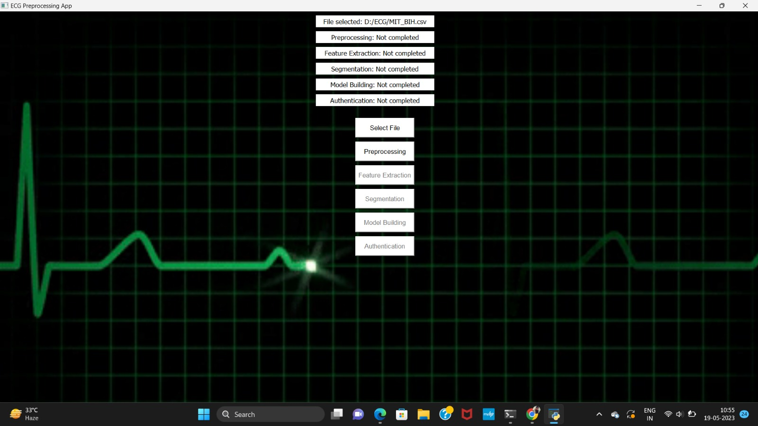
GRAPHICAL USER INTERFACE

Slide 15
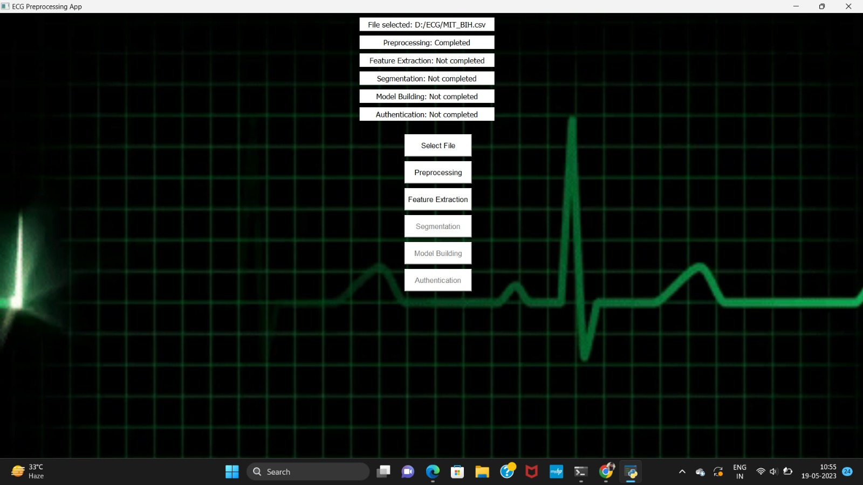
MODULE 1 RESULT
PREPROCESSING:

Slide 16
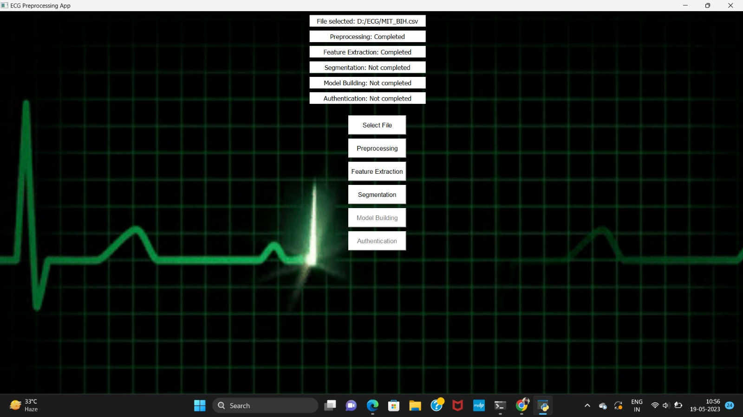
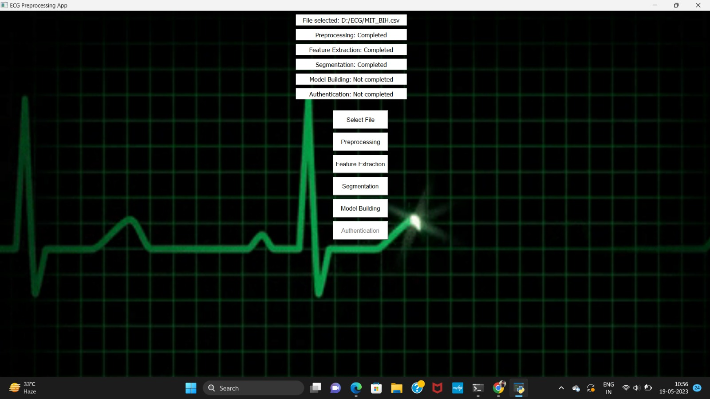
MODULE 2 RESULT

Slide 17
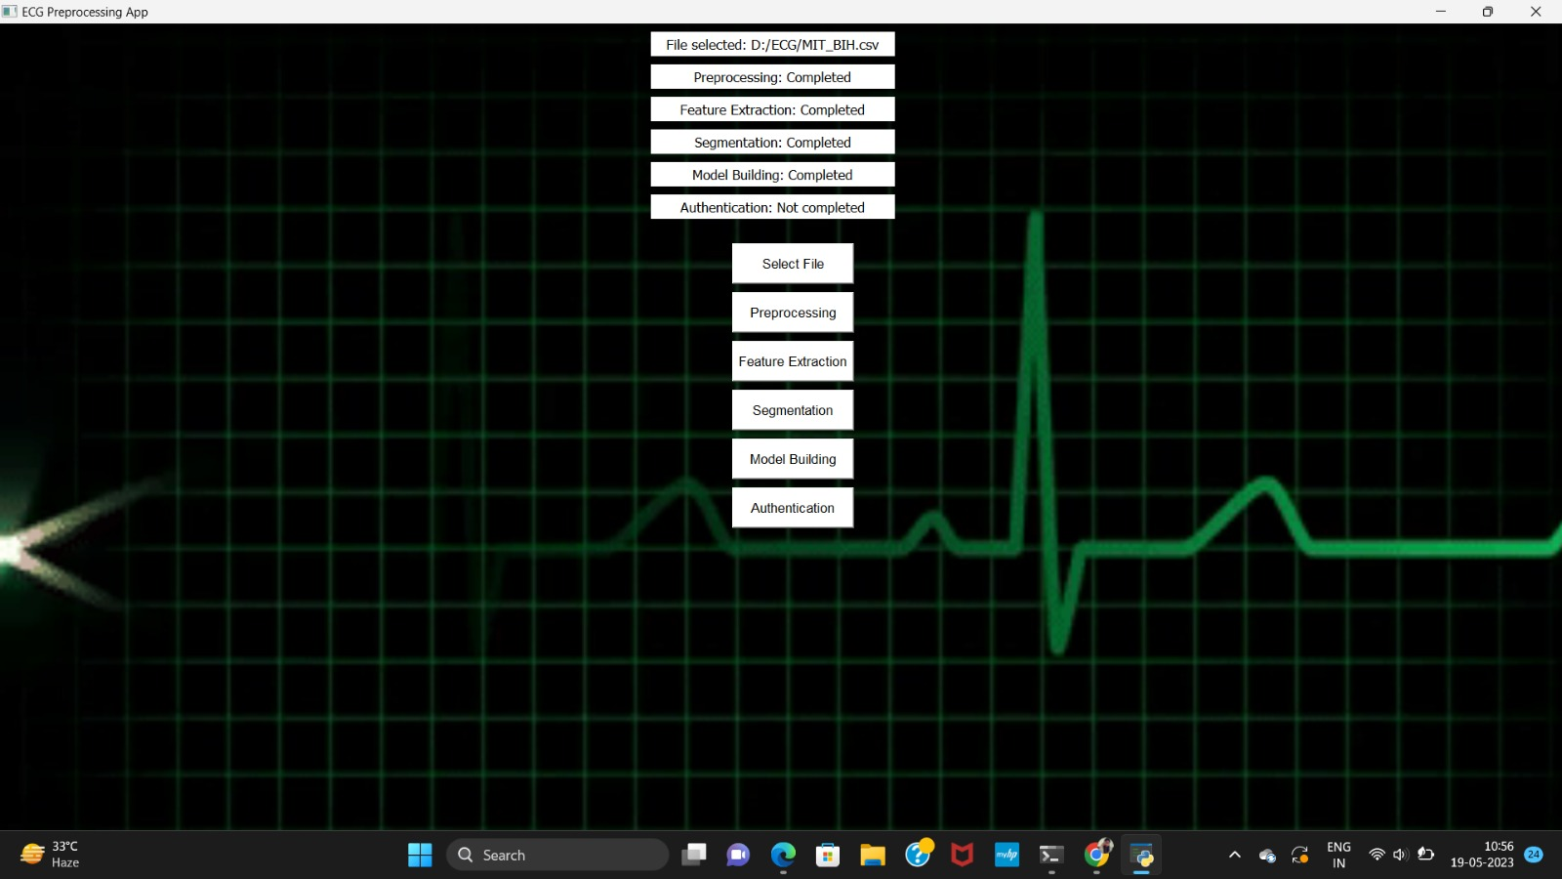
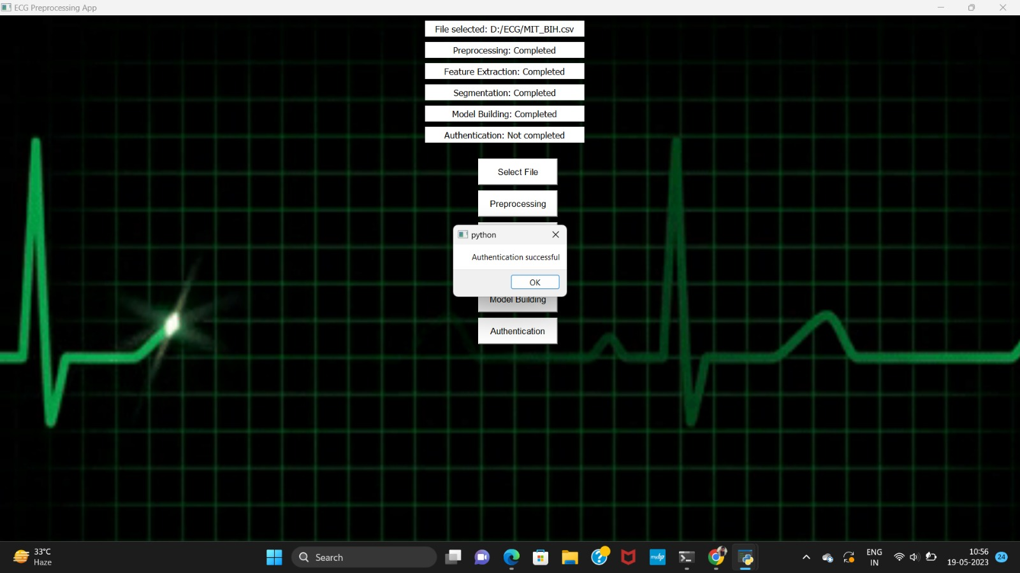
MODULE 3 RESULT

Slide 18
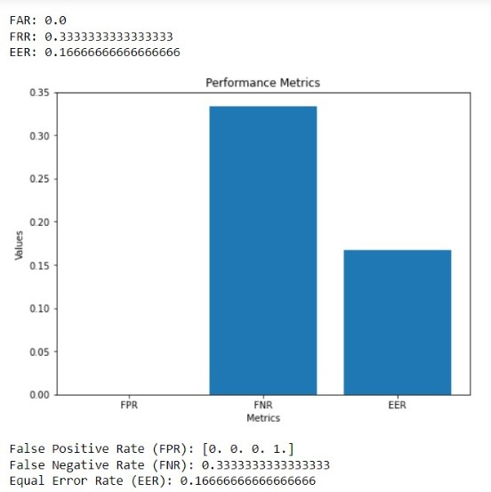
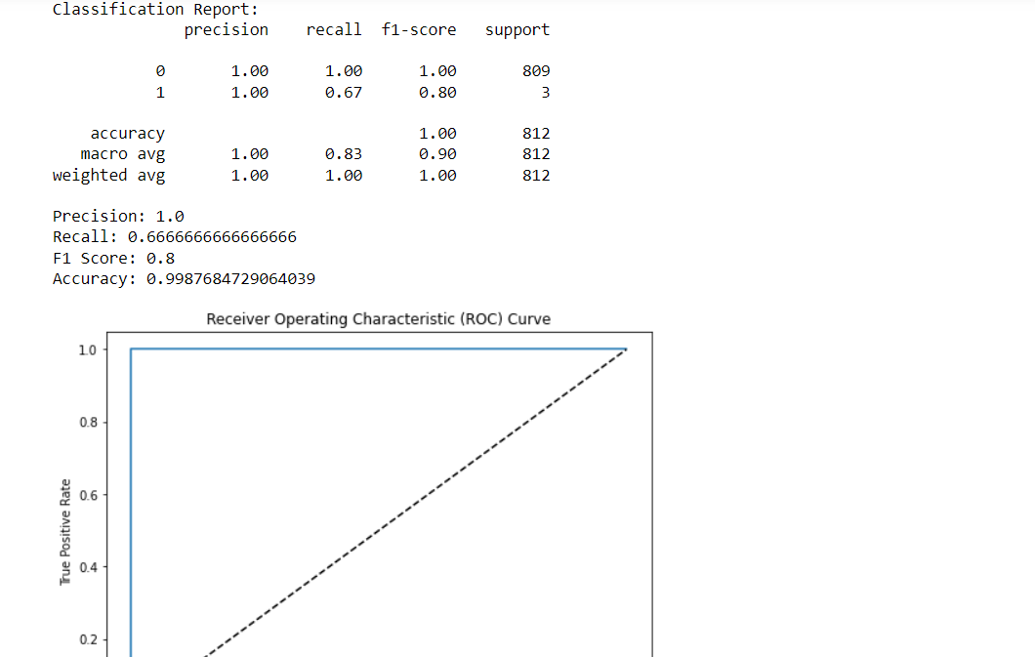
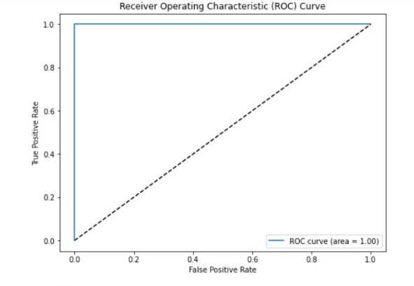
GRAPH

Slide 19
CONCLUSION & FUTURE WORK
CONCLUSION:
EDITH:ECG Biometric Aided by Deep Learning for Reliable Individual Authentication is a promising technology that utilizes deep learning algorithms to authenticate individuals based on their unique electrocardiogram (ECG) signals. The use of ECG biometrics for individual authentication is a novel and secure method that has the potential to revolutionize the field of biometric authentication.
The unique electrical activity of the heart provides a highly personalized biometric signature that is difficult to replicate or steal. The use of deep learning algorithms enhances the accuracy and robustness of the authentication system.
However, there are still some challenges that need to be addressed in the development and implementation of ECG biometric authentication systems, such as the need for specialized ECG sensors, potential privacy concerns, and the need for further research to validate the effectiveness of the system. Nevertheless, ECG biometric authentication has the potential to provide a secure and convenient means of authentication in various applications, including healthcare, finance, and security.

Slide 20
FUTURE WORK:
.
The use of wearable ECG sensors would make EDITH more practical and accessible, allowing individuals to authenticate themselves on-the-go, without the need for specialized equipment.
Additionally, the system could be integrated with wearable devices to provide continuous authentication and monitoring of the user's ECG signals.
Another potential enhancement could be the development of a user-friendly interface for EDITH, making it more accessible to a wider range of users.
It could also be interesting to investigate the possibility of using EDITH for continuous authentication in high-security environments, such as military or government facilities, where reliable individual authentication is crucial

Slide 21
REFERENCE
1. E. Maiorana, “EEG-based biometric verification using siamese CNNs,” in Proc. Int. Conf. Image Anal. Process., 2019, pp. 3–11.
2. A. K. Jain and K. Nandakumar, “Biometric authentication: System security and user privacy,” IEEE Comput., vol. 45, no. 11, pp. 87–92, Nov. 2012.
3. L. Biel, O. Pettersson, L. Philipson, and P. Wide, “ECG analysis: A new approach in human identification,” IEEE Trans. Instrum. Meas., vol. 50, no. 3, pp. 808–812, Jun. 2001.
4. D. Belo, N. Bento, H. Silva, A. Fred, and H. Gamboa, “ECG biometrics using deep learning and relative score threshold classification,” Sensors, vol. 20, no. 15, 2020, Art. no. 4078.

